Slide 1
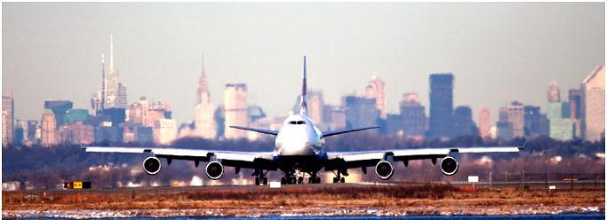

EDA of New York City Flight Data -2013

Slide 2
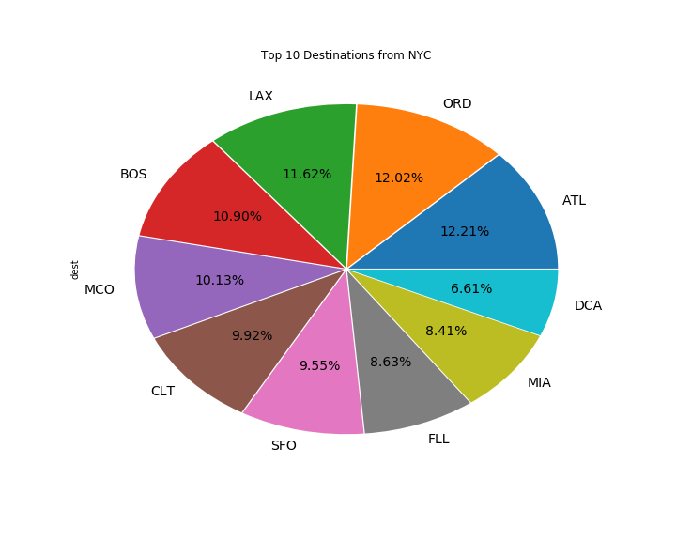
Top 10 destinations from NYC
ATL had 12.21% number of flights from NYC followed by ORD 12.02%.
DCA had the least, accounting to 6.61% of the total flights from NYC

Slide 3
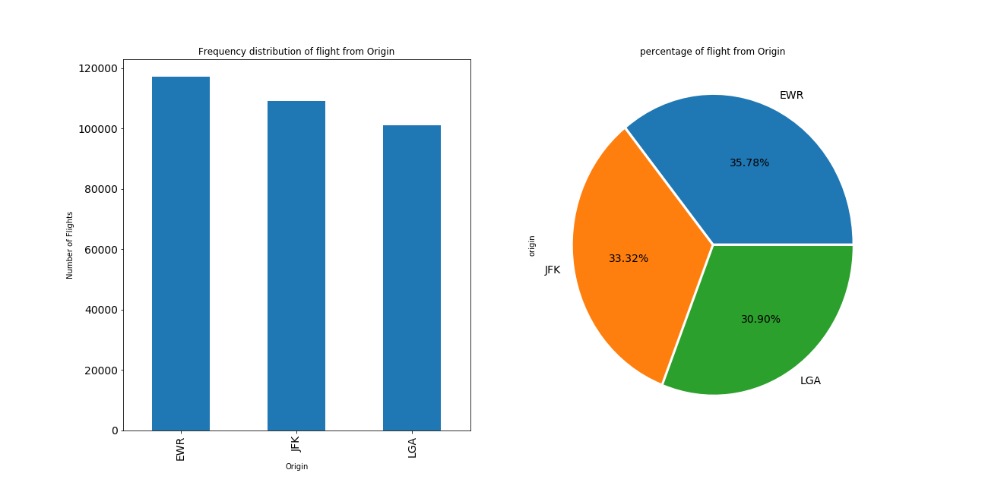
How much is the Distribution of flights from Origin
From the Origin the EWR had 35.78 %, JFK had 33.32% and LGA had 30.90%

Slide 4
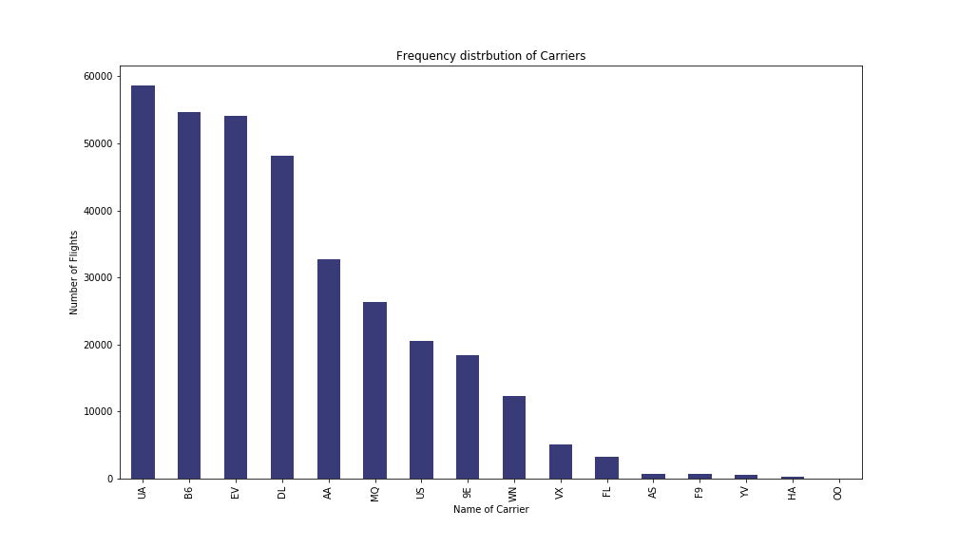
Which carrier transits maximum passengers
UA had transits 58000 flights, where as HA and OO had the least in 2013

Slide 5
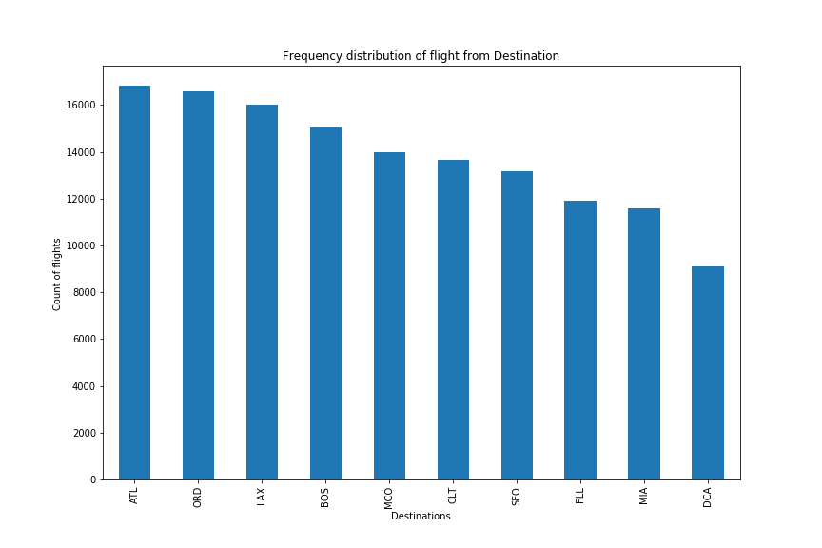
Which were the frequently travelled destinations
From the flight data we could understand that ATL, CRD ,LAX were the hot destinations of 2013

Slide 6
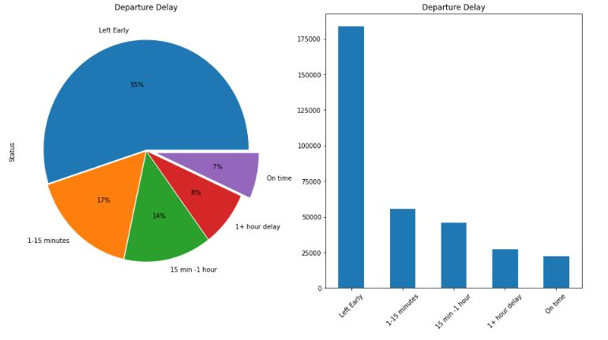
What does departure delay data says?
Flights which departure On-time is 7%,
55% flights leave early which need to be controlled
17% flights had less than 15 minutes delay.
Moreover, 8% fights had 1+ hour delay is worst case.

Slide 7
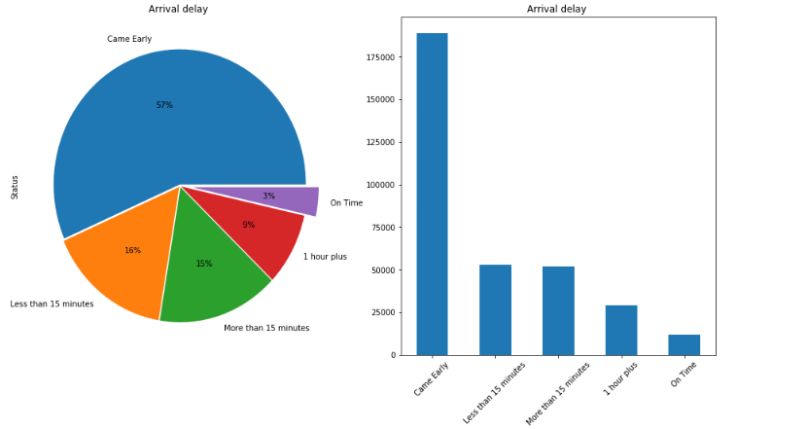
What does arrival delay data says?
The 57% flights came early.
Flight which came on-time is too less i.e. 3%, this needs to be improved
Less than 15 minutes delay account to 16%

Slide 8
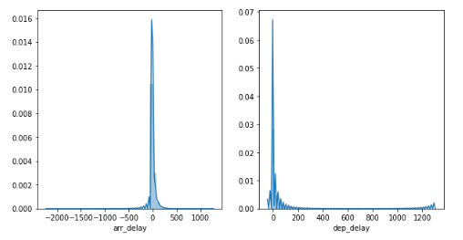
Departure delay and arrival delay
Histogram shows delay is on left side of Graph with a long tail to right this shows that delays were short and mostly loaded in time
Departure delay says frequency of flights with higher delay is very less but 30 minutes to 1 hour delay was common in 2013. This was not expected

Slide 9
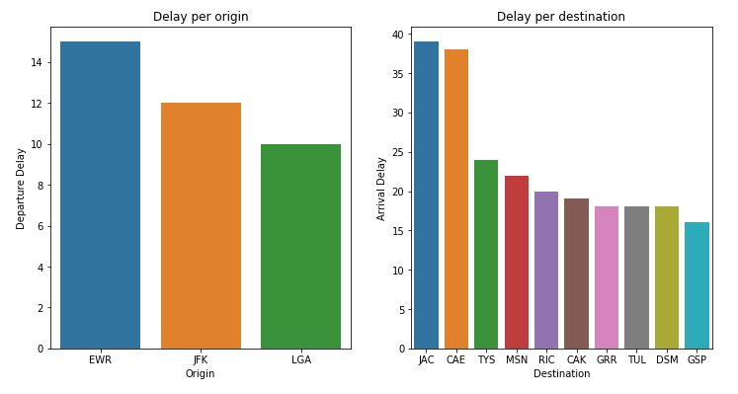
Identifying delay based on origin & destination
From this we could understand that EWR was the biggest delay maker,
JAC and CAE suffers from maximum arrival delay of 39 & 37 minutes per flight

Slide 10
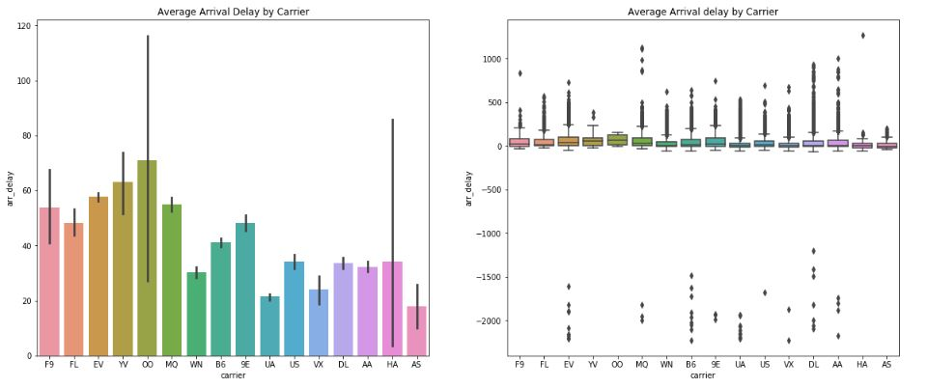
How much is the arrival delay per carrier
Carriers with higher average delay generation were Skywest Airlines(OO) with 70 minutes per flight, Mesa Airlines (YV) with 60 minutes per flight, and Atlantic Southeast Airlines (EV) with 59 minutes per flight.
The error bar provide the insight that airlines with low number of flights having higher standard deviation distribution from the mean (OO, HA, YV, F9, AS); so it seems like size matters.

Slide 11
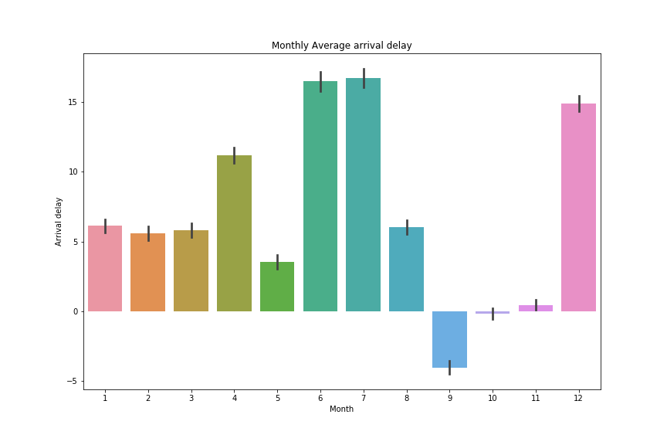
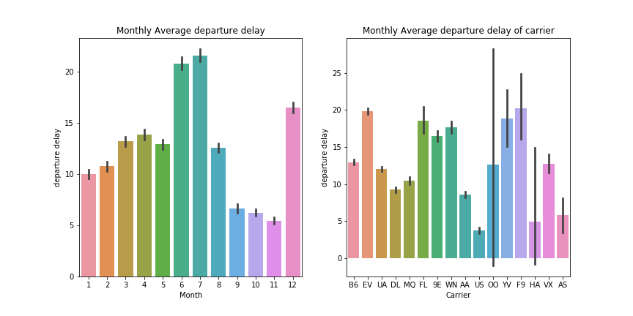
How much is the monthly delay
This shows that June, July and December, had the highest delay in Arrival of flights whereas in
September most flights trend to arrive before time . October shows on-time arrival
Carriers with Higher avg delay generation are OO with 60 minutes, YV with 50 min, 9E with 49 minutes.
Departure delay is high in June, July and least in November.
F9, YV, had highest delay whereas Hawaiian Airlines (HA ) is an exception because of long error bar.

Slide 12
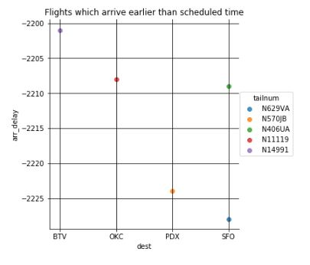
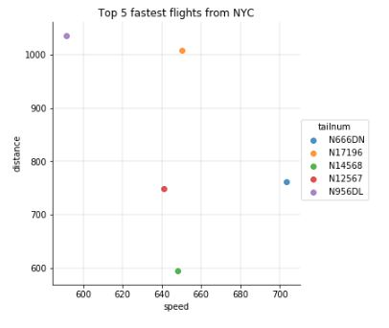
Speed V/S On-time arrival
We cannot find any common flights in the Top 5 List
As distance increases speed of flight decreases and it is inversely proportional
This shows that faster the flight does not mean it comes on-time.
So speed is not the only factor which can influence the punctuality of flights.

Slide 13
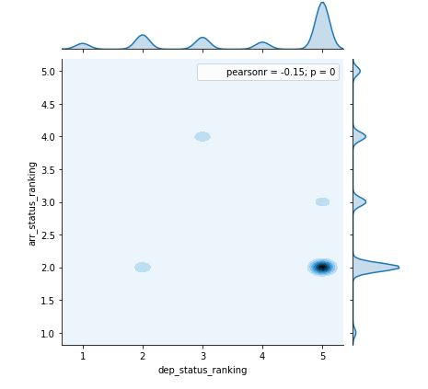
Density of departure and arrival delay
This show the flights which were on time was too less
Flights which departure before scheduled time arrives early and this need to be controlled
Controlling departure delay will help in minimising approx. 57% of departure and arrival delays.

Slide 14
Conclusion
Extreme delays occur in the months of June, July and December
Most of the flights leave early i.e. 55% which need to be controlled
Controlling early departure could help in reducing delay issues by 57%.
Delayed flights could not reach on time by increasing the speed.
EWR & JAC were the locations which need immediate attention.

